Slide 1
CYBERGENERATIONS

Slide 2





Introduction to Cybersecurity
Password Management
Phishing, Smishing, Vishing
Internet Scams and Fraud
Social Media Safety
Lets Practice!
Notes:
DO
Read aloud each lesson that CyberGenerations will cover.
SAY
By the end of this workshop, you will have the knowledge and confidence to secure the technology you use every day.

Slide 3

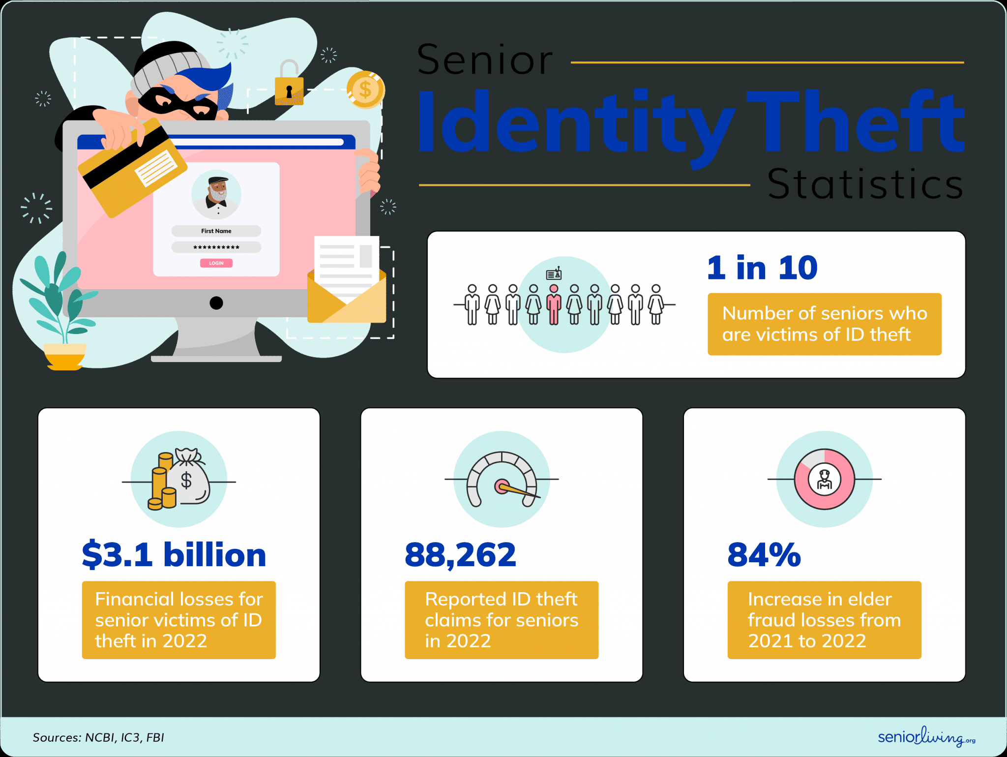
WHAT IS CYBERSECURITY?
Why is it important for us to learn about cybersecurity?
Notes:
https://www.seniorliving.org/identity-theft-protection/statistics/
This slide as 1 build.
This slide has 1 build.
ASK
Why is it important for seniors to learn about cybersecurity?
SAY
Online fraud is the most common crime in the US. Almost one in ten people fall victim to identity fraud.

Slide 4
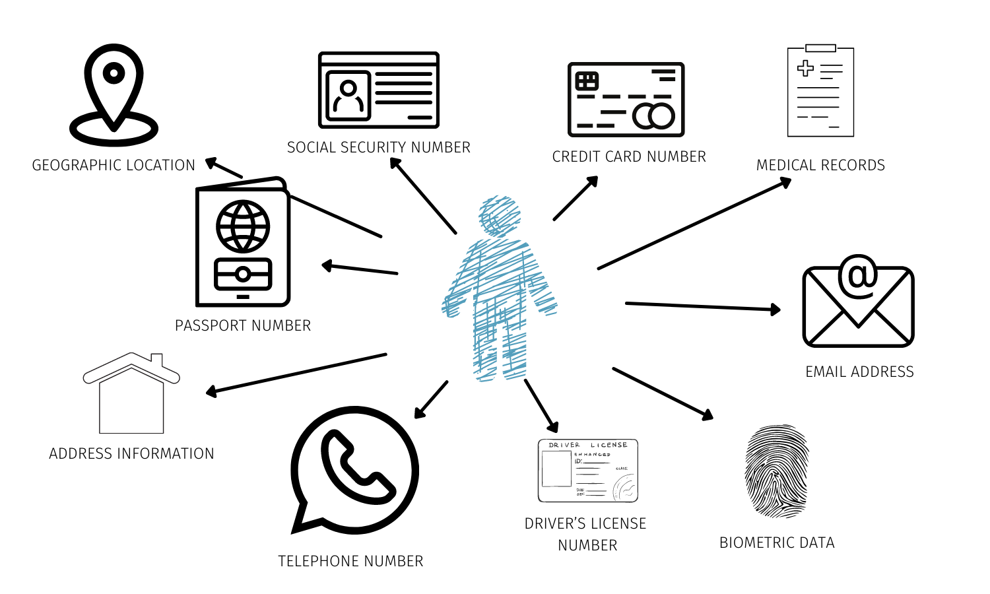
PERSONALLY IDENTIFIABLE INFORMATION (PII)
Personally identifiable information is any data that could potentially be used to identify a specific person.
Notes:
This slide has 1 build.
SAY
One of the biggest goals of cybersecurity is protecting personally identifiable information (PII). Personally identifiable information is any data that could potentially be used to identify a specific person.
ASK
Who can tell me some examples of PII?
Facilitator Note: Allow participants to yell out answers
Build 1
DO
Read through the examples of personally identifiable information.
SAY
Any of this information getting into the hands of an untrustworthy source could lead to fraud or identity theft. It’s important to treat your PII like you would a precious valuable!

Slide 5

PERSONALLY IDENTIFIABLE INFORMATION (PII)
Common Internet Myths
Myth 1: If you do not
put your information
online, you are safe
from intrusions.
Myth 2: If you post
something online,
it’s only shared with
your friends and family.
Notes:
ASK
Why is it important to be safe online?
Facilitator Note: Expected responses include - Protect your information, avoid scams or fraud
SAY
Lots of our data is stored online or on computers. Even if you don’t use computers regularly, it is still possible that your information is at risk. Two myths associated with using the internet are:
Myth 1: If you do not put your information online, you are untraceable and therefore safe from intrusions.
Truth: Publicly available government records, court records, or records of any organization or committee that you are a member of are all viable sources of personal information.
Myth 2: If you post something online, it’s only shared with your family and friends.
Truth: The internet is a mysterious place, and you never know where your information will end up. Even if you are being careful and deleting data which exposes personal information, there’s always a chance that your information has been copied and stored somewhere else and can be accessed by criminals.
Source:
https://www.atg.wa.gov/internet-safety-seniors

Slide 6
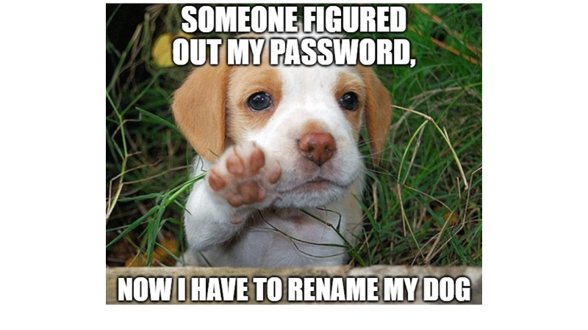
Passwords Matter

Slide 7


CREATING STRONG PASSWORDS
A password is string of characters used to verify the identity of a user during the authentication process.
Passwords help limit access to a system or application to only those users who are authorized to use it.
Notes:
SAY
Passwords help protect our personal information on the internet, and they are often the only things standing between cyber criminals and our sensitive data.
A strong password is not only important, but necessary.
Sources:
https://searchsecurity.techtarget.com/definition/password
https://www.techopedia.com/definition/4042/password

Slide 8
CREATING STRONG PASSWORDS
These bad examples of passwords are also some of the most leaked passwords of 2019:
Also avoid using birthdays, addresses, names of pets, and names of movies and TV shows as passwords
Do Not Use | Example
Consecutive numbers / keyboard letters | 1234567890, qwerty, asdfghj, 112233
Names | Michael, Daniel, Hannah, Jessica
Dictionary Words | Password, Monkey, sunshine, princess
Phone Numbers/SSN | 5555551234, 111230987
Notes:
SAY
These are some of the worst passwords you could use. Most of them made the list of top 100 leaked passwords in 2019.
DO
Review each example from the table on the slide.
SAY
You also want to avoid passwords that people could guess based on things they know about you, like your birthday, address, name of your pet, or the name of your favorite movie.
Source:
https://gbhackers.com/worst-passwords-2019/

Slide 9
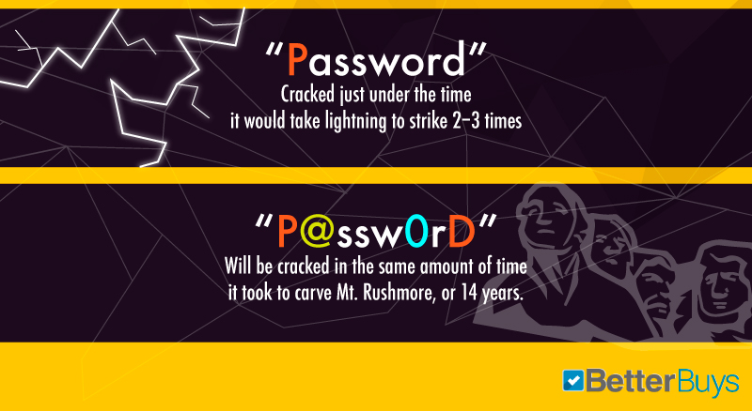
CREATING STRONG PASSWORDS
COMPLEX PASSWORD = STRONGER PASSWORD
UPPERCASE letters
Lowercase letters
Numbers (12345)
Symbols (@#$&*+)
Notes:
This slide links to an external resource.
SAY
Complex passwords can also contribute towards additional protection. To make a password harder to crack, always use a combination of:
UPPERcase letters
Lowercase letters
Numbers
Symbols
A simple, common word can be cracked in fractions of a millisecond. Mix in lowercase and uppercase letters, numbers, and symbols (think @, %, and #), and your password can be secure for more than a decade.
DO
Click the graphic to open Better Buys Password-Cracking Times. Type in examples of good and bad passwords to show audience the difference in the amount of time it takes to crack weak passwords versus strong passwords.
Source:
https://www.betterbuys.com/estimating-password-cracking-times/

Slide 10
PASSWORD GUIDELINES
Use a passphrase:
A turn an easy-to-remember phrase into a strong password by substituting letters with numbers and symbols
Where’s the beef?
Whd@b33f?
Notes:
SAY
Another way to increase password strength is to use a ‘Passphrase’:
A passphrase is a short phrase used as a password in which you can substitute letters with symbols and numbers.
Make sure that it’s a random sentence that has some meaning to you and not a famous quote or phrase.
Source:
https://www.techopedia.com/definition/4041/passphrase

Slide 11
PASSWORD GUIDELINES
Use different passwords for different accounts:
Create a strong base password and then add a site-specific extension
Example: [base password] [site]
Gmail: [Cocount!23$] [GMA] = Coconut!23$GMA
Facebook: [Coconut!23$] [FAC] = Coconut!23$FAC
Notes:
This slide has 1 build.
SAY
73% of people use the same passwords for all or most of their accounts.
ASK
Why is it a bad idea to use the same password for your Facebook, email, banking, or healthcare accounts?
SAY
If you use the same password for every account, a breach in one system could make your other accounts vulnerable as well.
Having multiple passwords can be hard to remember. A simple trick is to start with a base password and then add an abbreviation to the beginning or end that reminds you what account it is for.
Build 1
Starting with a base password, we can add GMA to signify Gmail and FAC to signify Facebook. You could add any prefix or suffix you would like, as long as you remember what it stands for.

Slide 12

PASSWORD GUIDELINES
Change passwords often:
Change your password every 6-12 months
Notes:
SAY
The longer you keep a password, the longer attackers can attempt to crack it.
If your password is vulnerable and is at risk of falling into the wrong hands, then changing your password often will shorten the amount of time a criminal might have to access your information using the weak password.
The recommended time for changing passwords is once every 90 days. But if this is too often for you, make sure to change your passwords at least once every 6-12 months.

Slide 13
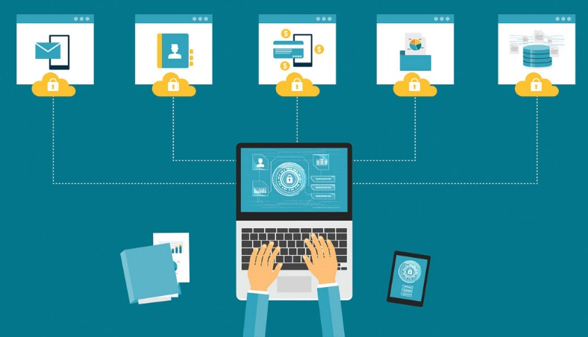



PASSWORD MANAGEMENT SYSTEMS
Password management systems store your login information for all the websites you use and help you log into them automatically
Notes:
SAY
A password management system is a software application that stores and manages a user’s passwords for various online accounts. A user can store account log-in information for all their accounts in one place, therefore only having to remember one main password.
ASK
Does anybody here already use a password management system?
Facilitator note: If yes, ask which systems? If no, mention recommended systems shown on the slide.
SAY
One thing to keep in mind, however, is that you shouldn’t rely on password management systems that are built into web browsers.
Browsers like Google Chrome will ask if you want to save a password or “auto-fill” information. You should always click No. They can’t compete with dedicated services which have a lot of useful features, offer a more powerful interface, and are a lot more secure.
Source:
https://www.howtogeek.com/141500/why-you-should-use-a-password-manager-and-how-to-get-started/

Slide 14

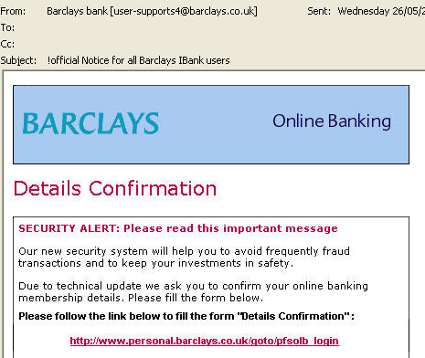
SOCIAL ENGINEERING
Phishing:
Fake senders
Incorrect URL
Spelling errors
Low Resolution Images
Numerous Recipients
Sincerely,
Customer Service
Barclays
Notes:
SAY
Now let’s look more closely at phishing, vishing, and smishing.
ASK
By a show of hands, who here has ever received a suspicious email from a company or organization, but wasn’t sure of its authenticity?
SAY
This example of a spam email has clues for what to look for to identify the legitimacy of emails you receive from a company or organization. The user received an email from their financial institution, it looks real but let’s take a closer look at some specific details:
Look at the email address of the sender: user-supports4@Barclays.co.uk (questionable identity: think, why does it say user-supports4?).
Now the Subject: this subject has an obvious spelling error/typo (an automated email from a company will rarely have a typo).
The text in an email is the most important. Think to yourself: Are caps appropriate? Why are they asking me for personal information over email?
Be wary of links or attachments. You can hover your mouse over the link and see its true destination, you can google the site and see if it comes back as a safe site, question if the link looks fishy – if it does, DO NOT CLICK.
Authentic emails are almost always signed by individuals.
A scam is never totally obvious. It’s up to the user to question and think of the reason behind the email received. When in doubt, call the institution directly. It never hurts to go to the direct source.

Slide 15

SOCIAL ENGINEERING
Vishing (aka Neighbor Spoofing) uses numbers that look like they are from your area
Vid: Cybersecurity with Robin Saunders -What is Phishing, Smishing & Vishing (youtube.com) (8:45 mark)
Notes:
This slide links to an external resource.
SAY
Neighbor spoofing is a particularly devious method used for vishing attempts whereby the criminals try to trick people into answering calls by mimicking their number or by using a number that looks like someone is calling from the same area as them.
DO
Open the Cyber Aware Neighbor Spoofing video (click the image).
Video URL:
https://www.youtube.com/watch?v=zYhcM1KA2q8

Slide 16
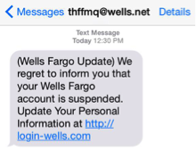
SOCIAL ENGINEERING
SMiShing:
Only open and reply to text messages from numbers you know
Don’t text back someone asking for personal information
Don’t click on random links (fake company websites!)
Report spam texts to your carrier by forwarding it to the number 7726 (SPAM),
free of charge.
Notes:
SAY
Smishing is a text message that leads you to a fake website that imitates a real company. That site will ask for personal information – username, password or credit card information. It’s called Smishing because texts are called "short message system" or SMS.
AT&T recommends the following steps for protecting yourself against smishing:
Only open and reply to text messages from numbers you know and trust.
Don’t text back someone who is asking for personal information.
Don’t click on links included in a text message.
You can report spam texts to your carrier by forwarding it to the number 7726 (SPAM),
free of charge.
Source:
about.att.com/pages/cyberaware/ae/smishing

Slide 17







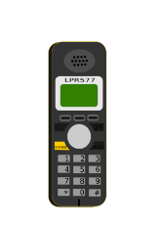
TYPES OF SCAMS
Government Agencies
IRS, FBI, FTC, etc.
Financial Institutions
Bank, PayPal, 401K
Insurance Companies
Home, Health, Car
Donation Organizations
Unknown or newly formed
Dating Sites
Fake Sites
Online/Phone Surveys
Claim to be service providers
Notes:
SAY
Almost any type of organization has its fair share of scammers.
Common agency scams stem from the IRS, FBI and the Federal Trade Commission. While these scams genuinely do not come directly from the government agencies, this is a typical scam that many people fall victim to.
Financial and investment companies are easy targets, with so many people signed up for online banking and alerts.
Be assured, financial institutions will never ask for personal information through email and will not ask you for personal information during an unsolicited call.
Dating sites, online and phone surveys as well as false correspondence from donation organizations are just a few more examples of potential scam risks.
One of the most important tips to remember is that you are never obligated to share information if you feel uncomfortable.
If you question the authenticity of any call or email, it is best to contact the company directly (using the number on their website) to verify the authenticity of the caller.

Slide 18
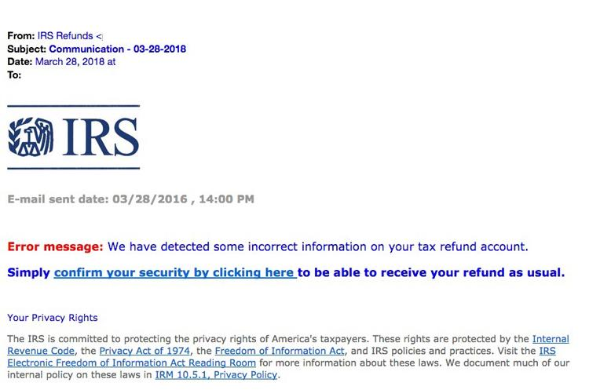
TYPES OF SCAMS
IRS / Tax Scam
Fraudulent email (or call) that claims be from the IRS.
Do not reply to the message.
Never give out personal or
financial information.
Forward the email to
phishing@irs.gov. Then delete it.
Don’t click links or attachments.
FAKE
Notes:
SAY
An IRS phishing scam is an unsolicited, fraudulent email that claims to come from the IRS. Some emails link to fake websites which look real. The goal is to lure victims to give up their personal and financial information. If the thieves get what they are after, they use it to steal a victim’s money and/or identity.
ASK
Have any of you ever received such communication and if so, what did you do?
SAY
If you think you have received an IRS scam phone call or email:
Hang up or delete the message.
Never give out personal or financial information.
Report the email to phishing@irs.gov.
Source:
https://www.irs.gov/newsroom/dont-fall-for-scam-calls-and-emails-impersonating-irs

Slide 19

TYPES OF SCAMS
Send Money Scam
Commonly referred to as ‘grandparent scam’
You receive a call or email from a friend or family member asking for money
The person is desperate for financial help
because they are stranded out of the
country, lost their wallet or are injured
The caller or emailer asks for money to
be wired to a specific location
Notes:
SAY
In a send money scam (also referred to as a grandparent scam), fraudsters either pretend to be the victim’s grandchild, friend, or some other family member.
The imposters claim that they are in trouble and need money to help with an emergency (e.g., getting out of jail, paying a hospital bill, or leaving a foreign country).
These scams tend to target senior citizens. If you receive a phone call or an email from a loved one asking for money urgently, always make sure to verify the story independently before you take any action.
Source:
https://www.aging.senate.gov/imo/media/doc/217925%20Fraud%20Book%20Final.pdf

Slide 20
TYPES OF SCAMS
Foreign Lottery Scam
Calls or emails that claim you’ve won the Lottery or some other prize. They ask for a small fee or taxes to send your winnings.
You will never win a contest of
any kind if you did not enter it.
Ignore all calls or emails
claiming you’ve won
NEVER share personal or
banking information
“Congratulations! You may receive a certified check for up to $400,000,000 CASH
One Lump sum! Tax free!
Notes:
SAY
If you ever receive a call or email saying you have won the lottery in a different country, then you’ve been the target of a foreign lottery scam.
The call or email comes from some foreign lottery company notifying you that you have won a large amount of money.
These emails usually look very professional with a subject line that congratulates you on winning the lottery and then the body of the email usually requests personal information like your full name, date of birth, or phone number.
If it is a call, the person on the other end usually has a strong foreign accent to make it seem more legitimate.
DO NOT provide any personal information.
Remember, you can’t win contests you didn’t enter.
Source:
https://www.moneycrashers.com/common-email-internet-scams/

Slide 21
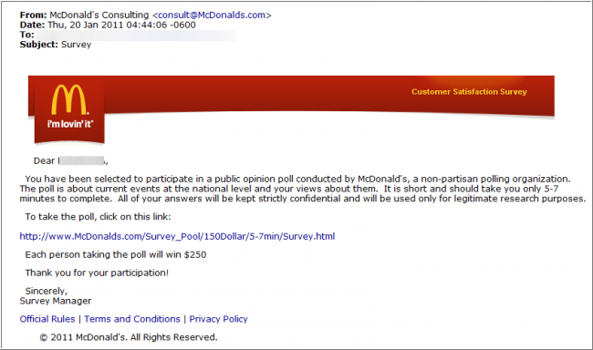
TYPES OF SCAMS
Survey Scam
An email that prompts you to click on suspicious links to complete a survey for a prize
Do NOT click the
link!
Notes:
SAY
Survey scams are very common and usually come in the form of an email that prompts you to click on suspicious links to complete a survey and “win a prize.” You might also receive a phone call from companies claiming to be giving away expensive trips or grand prizes for completing the survey.
Do not click on the suspicious links.
Do not give out any personal or financial information.
Report the spam email or phone call to the relevant authority.
Source:
https://www.moneycrashers.com/common-email-internet-scams/

Slide 22

TYPES OF SCAMS
Money-making Scam
Emails promising a get-rich-quick scheme (think pyramid schemes)
Prompt you to purchase a “training kit”
Might ask you to pay a small registration fee
Do not click the ad/link
Report
Notes:
SAY
People love making a quick buck. Get-rich-quick scams promise that you can make some amount of money working from home and with minimum effort. Signs of a money-making scam include:
A prompt to purchase a trial kit or training package for a fixed amount to be paid over PayPal or by sending them a check.
The company is based overseas and provides little to no contact information.
A deal that sounds too good to be true (because it’s not true!).
If you think it is a scam, do a quick google search. You might find out that there is already some information online about the illegitimacy of the suspicious company.
Source:
https://www.moneycrashers.com/work-from-home-scams-list-fake-jobs/

Slide 23

TYPES OF SCAMS
Tech Support Scam - One of The Most Common
Phony tech support calls or pop-ups claiming there’s something wrong account/computer
Gain remote access to the victim’s
computer
Demand money to solve made-up issue
Might install harmful malware
Tech-support will not contact you
if you did not contact them first!
Notes:
SAY
REMEMBER: Tech support will not contact you if you did not contact them first.
This very CyberGenerations program was created when the CyberPatriot Commissioner received a phone call from his mother regarding the legitimacy of a “Microsoft” tech support agent asking for her log-in information. As it turned out, that phone call was a tech support scam!
In tech support scams, bogus tech support employees make calls claiming to be from trusted companies like Microsoft or Apple.
They tell you that they have detected a problem with your computer, and they need your login credentials to remotely access and fix the issue.
Once they have access to the computer, the hacker might demand money, or they might install malware on the computer that helps them steal valuable personal data from the victim.
The on-screen pop-up or email version of this scam similarly warns you about security issues on your computer. It instructs you to dial a number for help or to click a link to download antivirus software. It might look like an error message from your operating system or like antivirus software.
Do not call the number or click on the link!
Do not assume that people contacting you are working for the company they say they are.
Don't share personal or financial information.
Source:
https://usa.kaspersky.com/resource-center/threats/identify-and-remove-fake-pop-ups

Slide 24

TYPES OF SCAMS
Dating Scam
Con artists strike up a romantic relationships with unsuspecting victims and then ask for money through emotional manipulation or by devising fake emergencies.
Never give money to
somebody you haven’t met
Notes:
SAY
Scammers usually connect with their victims through some online dating site posing as interested singles looking to make a genuine connection with a like-minded individual.
Be cautious of people who claim to be madly in love with you, even before they have met you in person.
Beware of people who claim to be Americans working overseas, like soldiers.
Even if you feel a strong connection, do not ever send money to someone you haven’t met in-person.
Source:
https://staysafeonline.org/blog/3-internet-scams-targeting-seniors-avoid/

Slide 25
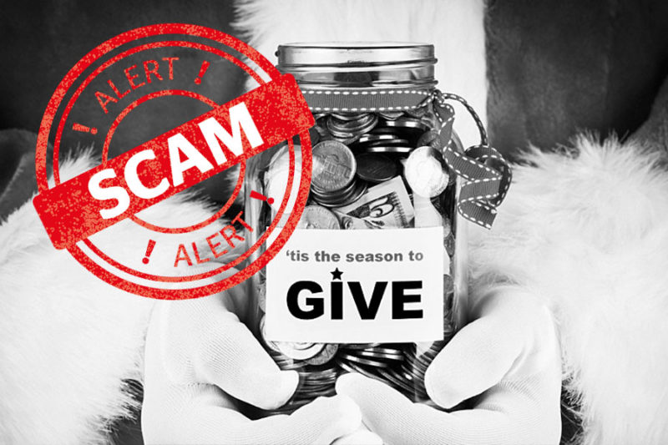
TYPES OF SCAMS
Charity Scam
Scammers take advantage of kind-hearted people and swindle them into “donating” to some fraudulent organization.
Usually from ‘new’ or unknown charities
Do not donate to charities you have
not heard of
Notes:
ASK
Has anyone here ever donated money to a charity you weren’t too familiar with, or maybe you’ve given to a door-to-door solicitor who claimed to be supporting a good cause?
SAY
Charity scams are usually very sophisticated, and many people fall prey to them on a regular basis. The scammers take advantage of kind-hearted people and swindle them into “donating” to bogus organizations.
Whenever there’s any natural disaster or ongoing humanitarian crisis, these scammers use high-pressure sales tactics to extract money from unsuspecting victims.
Do your research before donating to any organization.
Delete unsolicited emails and stick to organizations you know and trust.
Source:
https://www.investopedia.com/articles/personal-finance/073115/dont-donate-charity-scams-5-warning-signs.asp

Slide 26
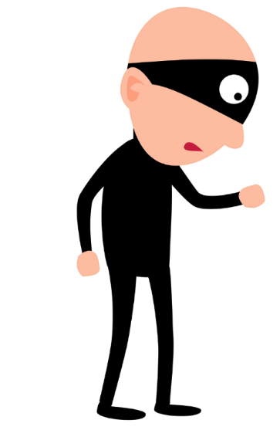

TYPES OF SCAMS
Identity thieves defraud people and the government by assuming the identities of unsuspecting victims and using that to commit a wide range of illegal activities.
What to do in case of identity theft:
Contact the organization where the theft
occurred and alert them
Contact a Credit Reporting Agency and ask
them to place a fraud alert for your credit report
Report identity theft to the FTC (www.IdentityTheft.gov)
Notes:
This slide has 3 builds.
This slide links to an external resource.
SAY
Identity thieves defraud people and the government by assuming the identities of unsuspecting victims and using those stolen identities to commit a wide range of illegal activities.
The increasing use of online tax filing services makes it even easier for scammers to steal your information and use it to make fraudulent tax claims.
Scammers may also use the stolen information to submit fraudulent billings to Medicare or Medicaid or to receive other social security benefits.
ASK
Identity theft is a serious issue. What should you do if your identity gets stolen?
SAY
Build 1
Contact the organization where the theft occurred and alert them.
Build 2
Contact a Credit Reporting Agency and ask them to place a fraud alert for your credit report.
Build 3
Report identity theft to the Federal Trade Commission (FTC) at IdentityTheft.gov
Facilitator note: If you wish to show the class the FTC website, click the link on the slide.

Slide 27







SOCIAL MEDIA SITES
Facebook Twitter Instagram
YouTube Pinterest LinkedIn
Notes:
ASK
By a show of hands, who here uses one or more of these social media sites?
Facilitator note: You may follow up by asking individual participants what sites they use and how often they use them.
If participants are not familiar with the functions of a particular site, use the explanations below:
SAY
Facebook is the most popular social media site among senior citizens and is used to connect with friends and family and share updates/photos.
Twitter allows users to broadcast short messages (“tweets”) in 280 characters or less.
Instagram allows users and brands to share captioned photos.
YouTube is a video-sharing website.
Pinterest is a digital pin board where users save content that they find interesting (often fashion-, cooking-, crafting-, and home décor-related content).
LinkedIn is a professional social media site that allows networking.

Slide 28



SOCIAL MEDIA SITES
Gear icon = Settings
It will allow you to make changes you account settings.
Lock icon = Privacy settings.
When you see a lock, think of safety and security.
Question mark icon = Help and Support
When in doubt, click a “?” to search for the topic you need assistance with.
Notes:
SAY
Securing your social media accounts is imperative to ensure a safe online experience.
Every site has its own privacy settings, which are accessible typically under the “settings” option.
When in doubt, search for “Privacy” and you will be able to navigate to the correct option which will let you make the desired changes.
Remember, the icons for privacy settings may vary from site to site.

Slide 29

SOCIAL MEDIA SITES
    Social Media Tips:
Do not post your location
Be careful with apps
Do not over-share
Customize security settings
Avoid using social media on public Wi-Fi
Be careful about who can access your contacts
Delete accounts you no longer use
Double check suspicious messages from your contacts
Notes:
This slide has 9 builds
SAY
There are many steps you can take to protect yourself from scams and information theft when using social media:
Build 1
Be picky: Only “accept” or “follow” friends you know in real life.
Build 2
Do not post your location: Friends who “tag” you may also be giving out your location.
Build 3
Be careful with apps: Games like Candy Crush or location/geography tracking apps may give away your location or other identifiable information. They might also require you to download harmful content or adware. Never allow apps to store your log in credentials.
Build 4
Do not over-share: Just because a site asks for info, does not mean you have to give it. Try submitting a form with the least amount of information. If it does not go through, only fill out the required criteria. Oversharing also applies to the photos and events you share with your friends or the world.
If you wouldn't say it to someone's face, you should not post it.
Build 5
Customize your privacy settings: Do not use the default settings. They usually only provide the bare minimum in security. Be sure to update your settings regularly, too.
Build 6
Avoid using social media on public networks: Public Wi-Fi is not secure, and you do not want to expose your login credentials over unsecure networks.
Build 7
Do not share your contacts: If hackers get ahold of your contact list, they might send dangerous spam emails or messages with malicious content meant to harm them.
Build 8
Delete accounts you no longer use: It is best to delete online accounts which haven’t been used in a long time.
Build 9
Do not reply to suspicious messages: Scammers can hack your friend’s account and send you a message trying to scam you. If you suspect that a certain message is fraudulent, directly contact the friend to verify the story.

Slide 30

Lets Practice- Activity 1
You receive the following email. How can you verify its legitimacy?
I am Kathy Smith and I work for the Foundation for Helping Veterans. The Foundation for Helping Veterans is a non-profit organization, and our Mission is to help those veterans who put their life at risk for this country and, as a result, are suffering from serious medical conditions.
Would you consider joining us to help make these veterans life better? This is an urgent call for help. If you really care, donate now! Your donation can make a significant difference in the life of a veteran hero. Just click on the PayPal link and it will redirect you to the payment page.
Sincerely,
Miss Kathy Smith
FOUNDATION OF HELPING VETERANS
Email: Rockysal.man@gmail.com
Notes:
Optional Activities
Facilitator Note: The activities/scenarios are optional. If you do not wish to cover these slides, skip ahead to Topic 6: Social Media Safety & Awareness
Divide the participants into smaller groups of 3 or 4 people.
Allow 5-7 minutes for groups to come up with their responses.
Suggestion slides are not an exhaustive list of correct answers, but merely a guide.
DO
Read the scenario aloud.
SAY
Work with your assigned group to find all the red flags. You should also try and come up with some suggestions for how you can verify the authenticity of this email.

Slide 31
How will you check?
Veteran-related charity scams are everywhere, and people need to be very careful before they donate:
Do your research. Search the charity online to verify if it’s a known scam.
Use the IRS’s Tax-Exempt Organization database to check your donation is tax-deductible.
If they ask you to send cash, wire money, donate gift cards, or leave money under your front door mat, do NOT do it.
Legitimate charities will provide a receipt.
Resist pressure or shame from the scammer to donate immediately before you can do your research.
Notes:
DO
Review Scenario 3 Suggestion slide once groups have presented their answers.
If time permits, visit the FTC link to go over the suggestions in details:
https://www.consumer.ftc.gov/articles/giving-charities-help-veterans

Slide 32
ACTIVITY 2
You receive a frantic phone call in the middle of the night from your grandson. While traveling internationally, his belongings were stolen and now he is stranded without any money.
He’s in trouble and needs your help urgently.
There’s no time to think!
Specific instructions for sending the money:
$5,000 cash. Must be sent via FedEx.
Cash should be divided cash into envelops then placed them between the pages of a magazine.
A mailing address that he urges you to note down quickly.
A quick hang up with no time to explain more. You need to act now!
Notes:
This slide has 1 build.
DO
Read the scenario aloud.
Build 1
SAY
Read this situation carefully and then work with your assigned group to come up with some suggestions for the steps you must take if you find yourself in this position. Note any red flags.
Source:
https://www.freep.com/story/money/personal-finance/susan-tompor/2019/05/09/grandparent-scam-send-cash-alert/1128797001/

Slide 33
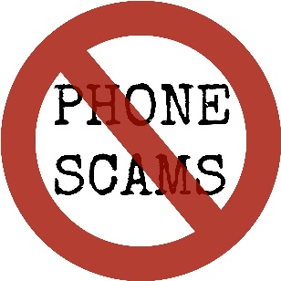
ACTIVITY 2: SUGGESTIONS
Scammers use this send-money scam to take advantage of a grandparent’s protective instinct. While we want to help our loved ones in need, it’s important to not have our despair used against us. Keep these tips in mind:
Beware of calls during odd hours.
Be wary if the person calling you gives very specific instructions about how to send the cash.
  The FTC says it’s possible to recover the cash if you have the tracking number and you act fast.
Even though it might seem harsh, make sure to ask specific questions to verify the identity of the person on the phone
Always give a call back to a number that you have saved
on your phone for the person asking for help.
Notes:
DO
Review Scenario 4 Suggestion slide once groups have presented their answers.
Source:
https://www.freep.com/story/money/personal-finance/susan-tompor/2019/05/09/grandparent-scam-send-cash-alert/1128797001/

Slide 34

ACTIVITY 3
Caller: Hello, I am calling from the Internal Revenue Service. The reason for this call is to inform you that the IRS is filing a lawsuit against you.
You: What?! Why is the IRS suing me?
Caller: You owe $3,455 in unpaid taxes. If you fail to pay this amount immediately, we will send the police to your house with an arrest warrant, Additionally, your assets and bank accounts will be frozen immediately
You: (Continue the conversation…What do you do?)
Notes:
SAY
This is the script. We have only provided the initial scenario. The participant playing the scammer will begin with the dialogue in the script. After the initial scenario is played out, you must continue the conversation.

Slide 35

ACTIVITY 3
Any of the following could indicate a scam call:
Demands of instant payment (Note: The IRS will always send a letter by mail first)
Demands of payment without giving you the chance to inquire or appeal
Instructions to use a specific payment method, such as a prepaid debit card or gift card.
Request for credit or debit card numbers over the phone.
Threats to bring in local police or other
law-enforcement groups to have you arrested.
Notes:
Facilitator Note: You will need two participants to play out the scenario. Alternately, the instructor can also play the role of the scammer making the call. This scenario can be played out a few different times with different participants, depending on the time left for the activity.
SAY
This role-playing game provides you with an example of a fraudulent call from the IRS demanding money and threatening with dire consequences if you fail to pay immediately. According to the IRS, any one of the following factors indicates a scam:
A call demanding instant payment. In fact, the IRS will not call about taxes payable without first sending you a bill by mail.
A call demanding that you pay taxes without giving you the chance to enquire or appeal the amount they say you owe.
Instructions to use a specific payment method, such as a prepaid debit card.
A call asking for credit or debit card numbers over the phone.
Threats to bring in local police or other law-enforcement groups to have you arrested.
Remember these tips when doing the role-playing scenario.
Source:
https://www.irs.gov/newsroom/scam-phone-calls-continue-irs-identifies-five-easy-ways-to-spot-suspicious-calls

Slide 36
Thank you
YOU HAVE AN IMPORTANT ROLE HELPING US PROTECT CYBERSPACE

Slide 37
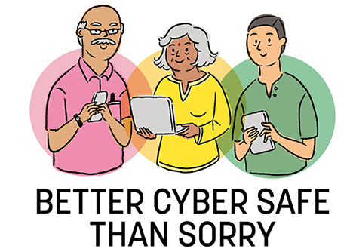
Resources
CISA
Cyber Tips

